Slide 1
Bias and Fairness
Pravin Y Pawar
Adapted from Google Machine Learning Course

Slide 2
Fairness
Evaluating a machine learning model responsibly requires doing more than just calculating loss metrics
critical to audit training data and evaluate predictions for bias
Machine learning models are not inherently objective
Engineers train models by feeding them a data set of training examples
This human involvement in the provision and curation of this data can make a model's predictions susceptible to bias.
Important to be aware of common human biases that can manifest in data
proactive steps can be taken to mitigate their effects

Slide 3
Types of Bias
Reporting Bias
Occurs when the frequency of events, properties, and/or outcomes captured in a data set does not accurately reflect their real-world frequency
Can arise because people tend to focus on documenting circumstances that are unusual or especially memorable
EXAMPLE:
A sentiment-analysis model is trained to predict whether book reviews are positive or negative based on a corpus of user submissions to a popular website. The majority of reviews in the training data set reflect extreme opinions (reviewers who either loved or hated a book), because people were less likely to submit a review of a book if they did not respond to it strongly. As a result, the model is less able to correctly predict sentiment of reviews that use more subtle language to describe a book.

Slide 4
Types of Bias
Automation Bias
Tendency to favor results generated by automated systems over those generated by non-automated systems, irrespective of the error rates of each
EXAMPLE:
Software engineers working for a sprocket manufacturer were eager to deploy the new "groundbreaking" model they trained to identify tooth defects, until the factory supervisor pointed out that the model's precision and recall rates were both 15% lower than those of human inspectors.

Slide 5
Types of Bias
Selection Bias
Selection bias occurs if a data set's examples are chosen in a way that is not reflective of their real-world distribution
Coverage bias: Data is not selected in a representative fashion.
EXAMPLE: A model is trained to predict future sales of a new product based on phone surveys conducted
with a sample of consumers who bought the product. Consumers who instead opted to buy a competing product
were not surveyed, and as a result, this group of people was not represented in the training data.
Non-response bias (or participation bias): Data ends up being unrepresentative due to participation gaps in the
data-collection process.
EXAMPLE: A model is trained to predict future sales of a new product based on phone surveys conducted
with a sample of consumers who bought the product and with a sample of consumers who bought a competing
product. Consumers who bought the competing product were 80% more likely to refuse to complete the survey, and
their data was underrepresented in the sample.
Sampling bias: Proper randomization is not used during data collection.
EXAMPLE: A model is trained to predict future sales of a new product based on phone surveys conducted with a
sample of consumers who bought the product and with a sample of consumers who bought a competing product.
Instead of randomly targeting consumers, the surveyer chose the first 200 consumers that responded to an email, who
might have been more enthusiastic about the product than average purchasers.

Slide 6
Types of Bias
Group Attribution Bias
Tendency to generalize what is true of individuals to an entire group to which they belong
Two key manifestations are:
In-group bias
A preference for members of a group to which you also belong, or for characteristics that you also share.
EXAMPLE: Two engineers training a résumé-screening model for software developers are predisposed to
believe that applicants who attended the same computer-science academy as they both did are more qualified for the role.
Out-group homogeneity bias
A tendency to stereotype individual members of a group to which you do not belong, or to see their characteristics as more uniform.
EXAMPLE: Two engineers training a résumé-screening model for software developers are predisposed to
believe that all applicants who did not attend a computer-science academy do not have sufficient expertise
for the role.

Slide 7
Types of Bias
Implicit Bias
Occurs when assumptions are made based on one's own mental models and personal experiences that do
not necessarily apply more generally
EXAMPLE:
An engineer training a gesture-recognition model uses a head shake as a feature to indicate a person is communicating the
word "no." However, in some regions of the world, a head shake actually signifies "yes."
Confirmation bias
Model builders unconsciously process data in ways that affirm preexisting beliefs and hypotheses
Experimenter's bias
In some cases, a model builder may actually keep training a model until it produces a result that aligns with their original
hypothesis
EXAMPLE:
An engineer is building a model that predicts aggressiveness in dogs based on a variety of features (height, weight, breed,
environment). The engineer had an unpleasant encounter with a hyperactive toy poodle as a child, and ever since has
associated the breed with aggression. When the trained model predicted most toy poodles to be relatively docile, the
engineer retrained the model several more times until it produced a result showing smaller poodles to be more violent.

Slide 8
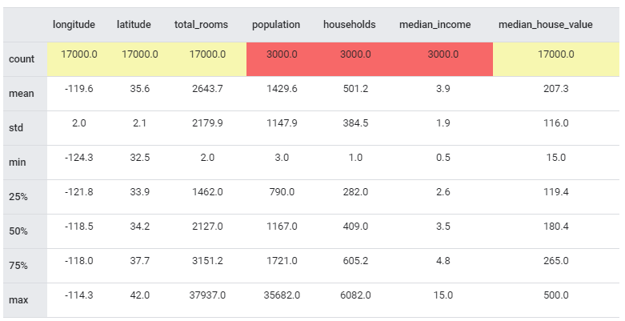
Fairness: Identifying Bias
Missing Feature Values
If your data set has one or more features that have
missing values for a large number of examples, that could be
an indicator that certain key characteristics of your data set are
under-represented.
For example, the table below shows a summary of key stats for a subset of features in the California Housing dataset
Suppose instead that three features (population, households,
and median_income) only had a count of 3000—in other words,
that there were 14,000 missing values for each feature.
These 14,000 missing values would make it much more difficult
to accurately correlate average income of households with median
house prices
Before training a model on this data, it would be prudent to
investigate the cause of these missing values to ensure that there
are no latent biases responsible for missing income and
population data.

Slide 9
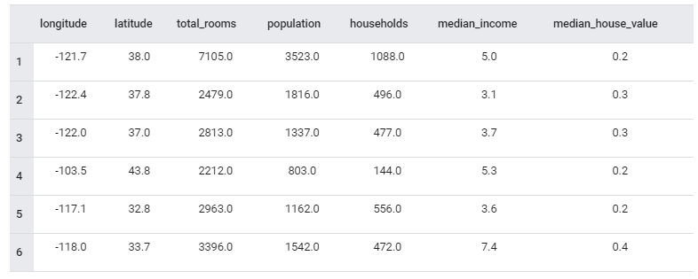
Fairness: Identifying Bias
Unexpected Feature Values
When exploring data, you should
also look for examples that contain
feature values that stand out as
especially uncharacteristic or unusual
These unexpected feature values
could indicate problems that occurred
during data collection or other
inaccuracies that could introduce bias.
Can you pinpoint any unexpected
feature values?

Slide 10
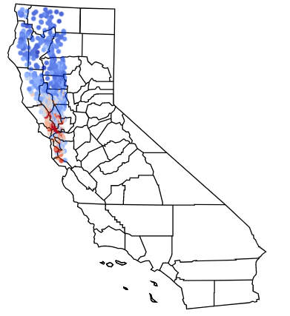
Fairness: Identifying Bias
Data Skew
Any sort of skew in your data, where certain groups or
characteristics may be under- or over-represented
relative to their real-world prevalence, can introduce bias
into your model.
Figure visualizes a subset of data drawn from the full housing data
set that exclusively represents the northwest region of California
If this unrepresentative sample were used to train a model to predict
California housing prices statewide, the lack of housing data from
southern portions of California would be problematic
The geographical bias encoded in the model might adversely affect
homebuyers in unrepresented communities

Slide 11
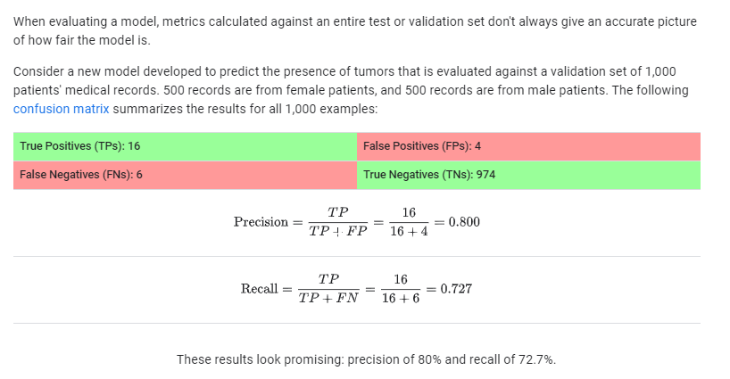
Fairness: Evaluating for Bias
Example

Slide 12
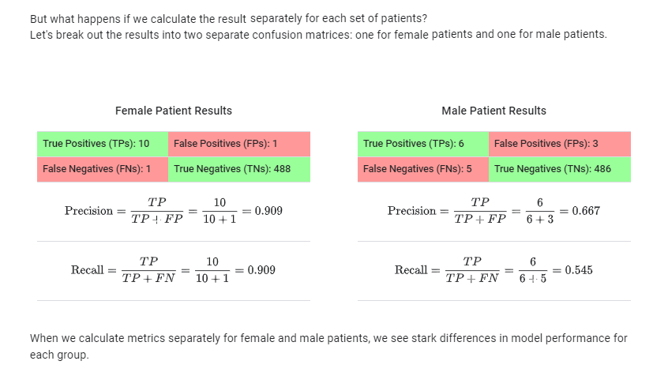
Fairness: Evaluating for Bias(2)
Example Continued

Slide 13
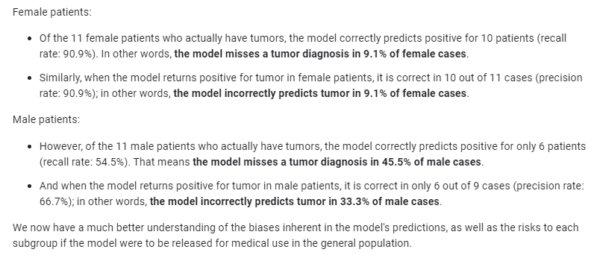
Fairness: Evaluating for Bias(3)
Example Continued

Slide 14
Thank You!
In our next session:

